Slide 1
Chapter 9
Resource Controller

Slide 2
Outline
Resource Controller
Create Resource Controller
Route list

Slide 3
Resource Controller

Slide 4
Resource Controller
A controller that handles all HTTP requests

Slide 5
Create Resource Controller
php artisan make:controller ControllerName --resource
Register route to the controller in web.php
Route::resource('routeURI', 'ControllerName');
See all the route in the application:
php artisan route:list

Slide 6
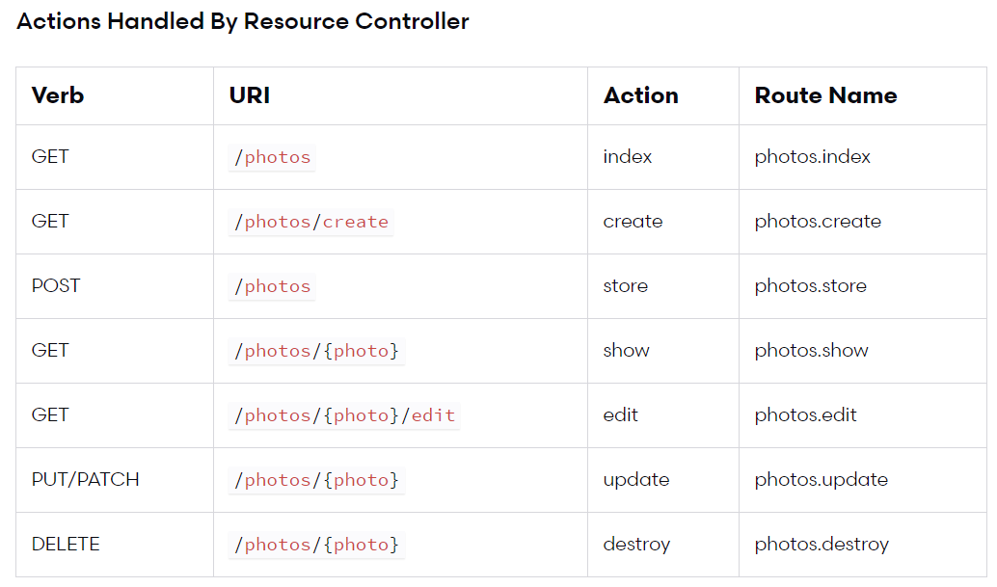

Slide 7
Demo
CRUD Post with Resource Controller

Slide 8
Activity[20mn]
CRUD the student information using Resource Controller

Slide 9
Activity[50mn]
CRUD the comment information using Resource Controller
Table comments has the following field
id
comment

